Slide 1



Problem Statement: College Clubs & Events Management Platform
Category: JUNIOR
Team Name: VERTEX
Team Leader: GEETANJALI KADAM

Slide 2


VISUAL REPRESENTATION

Slide 3
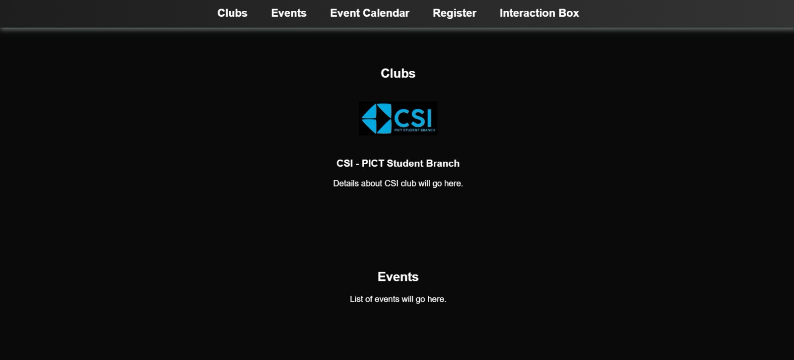

Slide 4
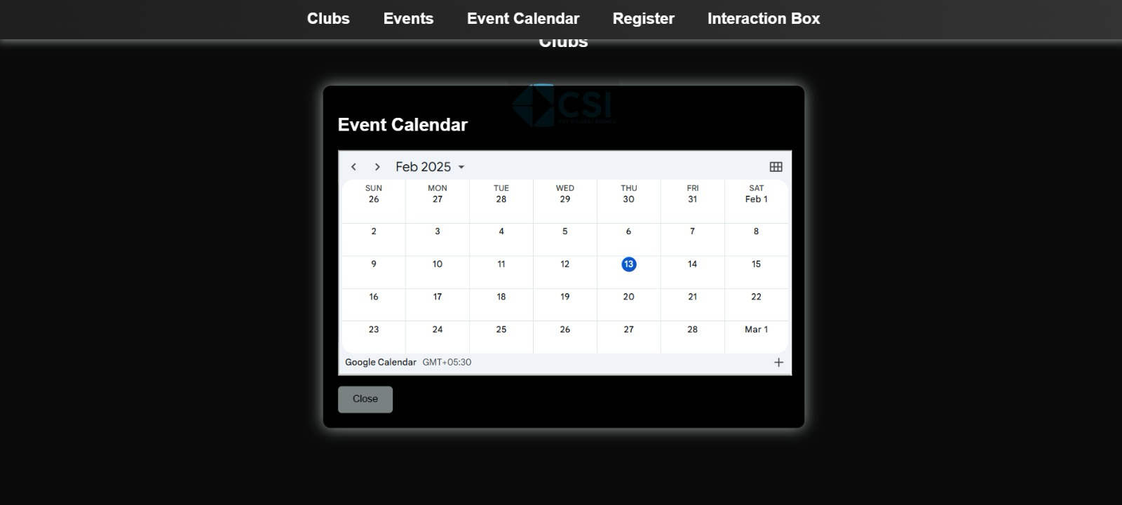

Slide 5
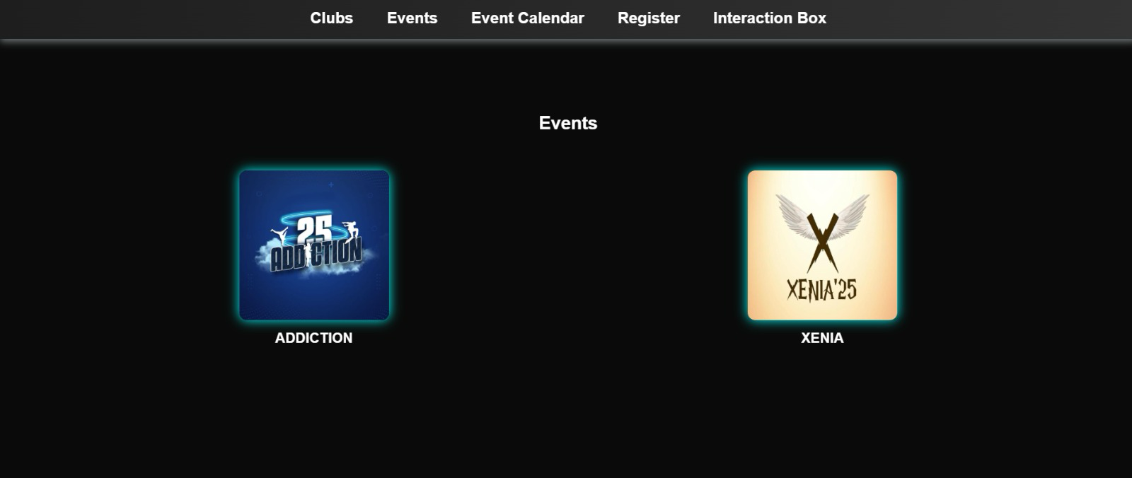

Slide 6
Tech Stack
Frontend: HTML, CSS, and JavaScript (with React for a more dynamic user interface, if desired) – employed to develop a responsive and intuitive interface.
Backend: Node.js with Express.js – effectively manages user requests, authentication, and database interactions.
Database: MongoDB (NoSQL) or Firebase – securely stores user information, club/event details, and participation records.
Authentication: Firebase Auth/Auth0 – guarantees secure user login and role-based access control (Student, Club Admin, Platform Admin).

Slide 7
Key Features
CORE FUNCTIONALITY
A streamlined platform to enhance efficiency, engagement, and organization in club operations with the following key features:
Member Management: Track member details, roles, and renewals.
Event Management: Plan, schedule, and monitor events effortlessly.
Communication: Send updates, alerts, and enable participant chats.
Access Control: Securely manage roles and permissions.
Reports: Analyze membership trends and financial data.
AI Assistance: Simplify event planning and task prioritization.
Awarded automated Certificates on behalf of clubs.

Slide 8
KEY ALGORITHMS
Key Algorithms Driving the Platform
Event Registration Handling Algorithm:
Validates user inputs (email, roll number, year, name, contact).
Ensures unique registrations and stores data in MongoDB.
Provides user feedback on registration status.
Event Calendar Integration Algorithm:
Dynamically displays the calendar with embedded iframe.
INSTANT QUERY SUBMISSION FORM ATTACHED BELOW OF WEBPAGE FOR USERS.
DARK AND LIGHT MODE INTEGRATED FOR COMFORT.
INCLUDED A GLIMPSES OF PREVIOUS YEARS CLUB ACTIVITIES FOR Visual attraction.
An instant scroll up button for ease.
And at last a social media page promotion of clubs.

Slide 9

Challenges and Approach
Challenge 1: Managing real-time event registrations
Approach: Use Firebase Realtime Database or WebSockets to ensure instant updates when students register for events.
Challenge 2: Secure authentication & user role management
Approach: Implement Firebase Auth/Auth0 for login and restrict access based on user roles (Student, Club Admin, Platform Admin).
Challenge 3: Efficient participation tracking & certificate generation
Approach: Store attendance data in the database and automate certificate generation using PDFKit or Canva API.

Slide 10
Challenges and Approach
Challenge 4:enquiry/complaint of users about events
Approach: included a form for users where they can register there enquiry and response can provided according.
Challenge 5: Light and dark mode for people with disorders or other problems.
Approach: implemented a solution for it as included a dark/light mode for club page.

